Slide 1

LET US C
BY YASHAVANT KANETKAR
CH 17 Q[A]
CH 17 Q[C]
CH 17 Q[A]
CH 17 Q[B]
CHAPTER 17 SOLUTIONS
STRUCTURES

Slide 2
LET US C
BY YASHAVANT KANETKAR
CH 18 Q[A]
CH 18 Q[C]
CH 18 Q[A]
CH 18 Q[B]
CHAPTER 18 SOLUTIONS
CONSOLE INPUT/OUTPUT

Slide 3


🔴Let me create amazing coding tutorials for you forever!🙂
👇👇👇👇👇👇👇👇👇👇👇👇👇👇👇👇👇👇
👉 SUBSCRIBE 🤛
CH 18 Q[C]
CH 18 Q[A]
CHAPTER 18 SOLUTIONS
CONSOLE INPUT/OUTPUT
CH 18 Q[B]
Thanks for your valuable time!

Slide 4
LET US C
BY YASHAVANT KANETKAR
CH 16 Q[B]
CH 16 Q[A]
CHAPTER 16 SOLUTIONS
HANDLING MULTIPLE STRINGS

Slide 5
LET US C
BY YASHAVANT KANETKAR
CH 17 Q[C]
CH 17 Q[A]
CH 17 Q[B]
CHAPTER 17 SOLUTIONS
STRINGS

Slide 6
LET US C
BY YASHAVANT KANETKAR
CH 16 Q[B]
CH 16 Q[A]
CHAPTER 16 SOLUTIONS
HANDLING MULTIPLE STRINGS

Slide 7
LET US C
BY YASHAVANT KANETKAR
CH 3 Q[C]
CH 3 Q[A]
CH 3 Q[B]
CHAPTER 3 SOLUTIONS
DECISION CONTROL INSTRUCTION

Slide 8
LET US C
BY YASHAVANT KANETKAR
CH 12 Q[C]
CH 12 Q[A]
CH 12 Q[B]
CHAPTER 12 SOLUTIONS
THE C PREPROCESSOR

Slide 9
LET US C
BY YASHAVANT KANETKAR
CH 4 Q[E]
CH 4 Q[C]
CH 4 Q[A]
CH 4 Q[D]
CH 4 Q[B]
CHAPTER 4 SOLUTIONS
MORE COMPLEX DECISION MAKING

Slide 10
LET US C
BY YASHAVANT KANETKAR
CH 7 Q[B]
CH 7 Q[D]
CH 7 Q[A]
CH 7 Q[C]
CHAPTER 7 SOLUTIONS
CASE CONTROL INSTRUCTION

Slide 11
LET US C
BY YASHAVANT KANETKAR
CH 4 Q[B]
CH 4 Q[A]
CHAPTER 4 SOLUTIONS
MORE COMPLEX DECISION MAKING

Slide 12
LET US C
BY YASHAVANT KANETKAR
CH 17 Q[C]
CH 17 Q[A]
CH 17 Q[B]
CHAPTER 17 SOLUTIONS
STRINGS

Slide 13
LET US C
BY YASHAVANT KANETKAR
CH 17 Q[D]
CH 17 Q[B]
CH 17 Q[C]
CH 17 Q[A]
CHAPTER 17 SOLUTIONS
STRINGS

Slide 14
LET US C
BY YASHAVANT KANETKAR
CH 9 Q[B]
CH 9 Q[C]
CH 9 Q[A]
CHAPTER 9 SOLUTIONS
POINTERS

Slide 15
LET US C
BY YASHAVANT KANETKAR
CH 13 Q[I]
CH 13 Q[G]
CH 13 Q[E]
CH 13 Q[C]
CH 13 Q[A]
CH 13 Q[H]
CH 13 Q[F]
CH 13 Q[D]
CH 13 Q[B]
CHAPTER 13 SOLUTIONS
ARRAYS

Slide 16
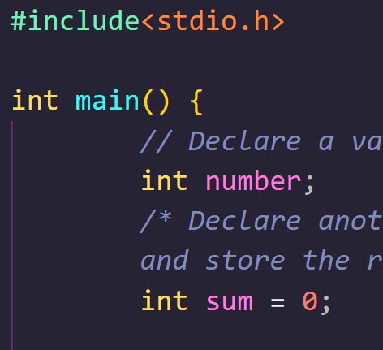
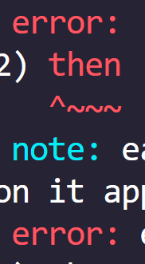

DEAR CODING

Slide 17
CHAPTER 3 SOLUTIONS
DECISION CONTROL INSTRUCTION
Q[A] What will be the output of the following programs:
CH 3 Q[A]
(a)
(b)
#include <stdio.h>
int main()
{
int a = 300, b, c;
if (a >= 400)
b = 300;
c = 200;
printf("%d %d\n", b, c);
return 0;
}
#include <stdio.h>
int main()
{
int a = 1600, b, c;
if (a >= 400)
b = 300;
c = 200;
printf("%d %d\n", b, c);
return 0;
}
(c)
CH 3 Q[C]
CH 3 Q[B]
(d)
(e)
DEAR CODING
(f)
BOOK: LET US C
BY YASHAVANT KANETKAR

Slide 18

CHAPTER 3 SOLUTIONS
DECISION CONTROL INSTRUCTION
(a)
#include <stdio.h>
int main()
{
int a = 300, b, c;
if (a >= 400)
b = 300;
c = 200;
printf("%d %d\n", b, c);
return 0;
}
👩‍💻 Output:
CH 3 Q[A](a)
✍️ b will contain some garbage value and c will be equal to 200.
DEAR CODING
BOOK: LET US C
BY YASHAVANT KANETKAR

Slide 19
CHAPTER 3 SOLUTIONS
DECISION CONTROL INSTRUCTION
Q[B] Point out the errors, if any, in the following C programs:
CH 3 Q[B]
(b)
(c)
(a)
#include <stdio.h>
int main()
{
int j = 10, k = 12;
if (k >= j)
{
{
k = j;
j = k;
}
}
return 0;
}
(d)
#include <stdio.h>
int main()
{
float a = 12.216, b = 12.162;
if (a = b)
printf("a and b are equal\n");
return 0;
}
(e)
(f)
DEAR CODING
(g)
BOOK: LET US C
BY YASHAVANT KANETKAR

Slide 20

CHAPTER 3 SOLUTIONS
DECISION CONTROL INSTRUCTION
(a)
#include <stdio.h>
int main()
{
float a = 12.216, b = 12.162;
if (a = b)
printf("a and b are equal\n");
return 0;
}
a == b
✅ No error!
CH 3 Q[B](a)
👩‍💻 Output:
✍️ 12.162 gets assigned to a so the if is now reduced to if ( a ) or if ( 12.162 ). Since 12.162 isn’t non zero, it is true hence printf() gets executed.
DEAR CODING
BOOK: LET US C
BY YASHAVANT KANETKAR

Slide 21
CHAPTER 3 SOLUTIONS
DECISION CONTROL INSTRUCTION
(d)
#include <stdio.h>
int main()
{
int x = 10;
if (x >= 2) then
printf("%d\n", x);
return 0;
}
CH 3 Q[B](d)
❌
ERROR!
DEAR CODING
✍️ There is no keyword "then“ in C & no variable defined here in program as well.
BOOK: LET US C
BY YASHAVANT KANETKAR

Slide 22

CHAPTER 3 SOLUTIONS
DECISION CONTROL INSTRUCTION
(d)
#include <stdio.h>
int main()
{
int x = 10;
if (x >= 2)
printf("%d\n", x);
return 0;
}
CH 3 Q[B](d)
DEAR CODING
BOOK: LET US C
BY YASHAVANT KANETKAR

Slide 23
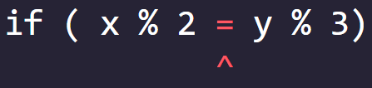
CHAPTER 3 SOLUTIONS
DECISION CONTROL INSTRUCTION
(e)
#include <stdio.h>
int main()
{
int x = 10, y = 116;
if ( x % 2 = y % 3)
printf("Carpathians\n");
return 0;
}
❌ ERROR!
CH 3 Q[B](e)
✍️ C allows only one variable on left hand side of “=“ assignment operator.
DEAR CODING
BOOK: LET US C
BY YASHAVANT KANETKAR

Slide 24
CHAPTER 3 SOLUTIONS
DECISION CONTROL INSTRUCTION
Q[C] Attempt the following:
(a) If cost price and selling price of an item are input through the keyboard, write a program to determine whether the seller has made profit or incurred loss. Also determine how much profit he made or loss he incurred.
CH 3 Q[C](a)
DEAR CODING
BOOK: LET US C
BY YASHAVANT KANETKAR

